Slide 1

Effect of Eyeglass on
Intelligent Perception
Do I look smarter?
Cohort B Team 7
Kunpeng Huang, Yoki Liu, Lyufan Pan, Yunlei Zhou, Jiayuan Zou, Sherry Zuo

Slide 2
TABLE OF CONTENTS
01
04
02
05
03
06
Treatment Effects
Causal Question of Interest
Limitations
Experiment Design
Experiment Data
Conclusion

Slide 3
Causal Question of Interest
The effect of wearing glasses on people’s perception of intelligence.
“whether wearing glasses make you look smarter?”
Treatment = Wearing glasses

Slide 4
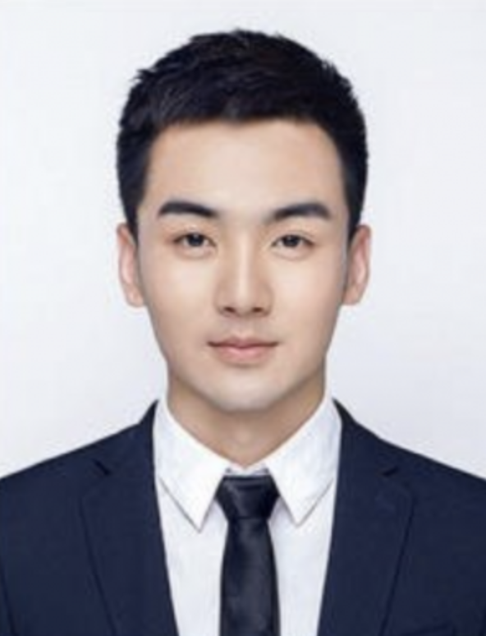
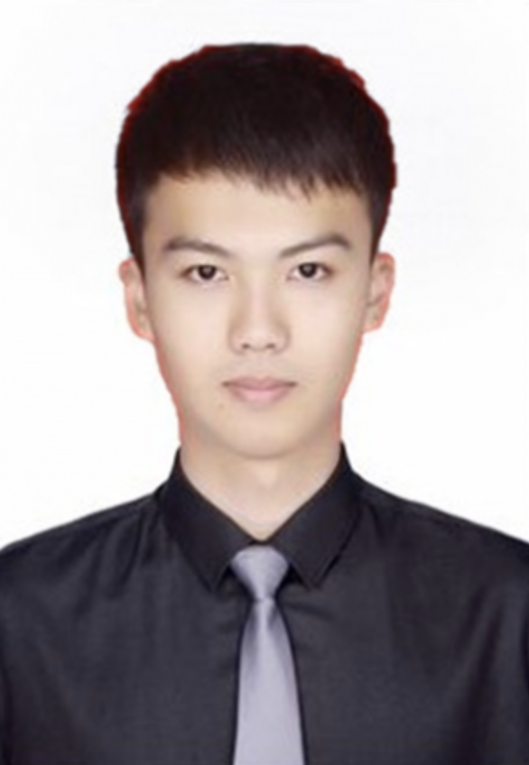

Experiment Design
Baseline
Control
Treatment
A/B Test on IP address level
Online Survey using Qualtrics
Randomization
Double Blinding
Baseline for benchmark
Photo Selection:
Excludability - only treatment changed
Pilot Experiment
Offensive question
Time limit
Person A
Person B
Notes:
People’s judgment on GPA might be very different. By adding a baseline, we create a benchmark for evaluating the effect.

Slide 5
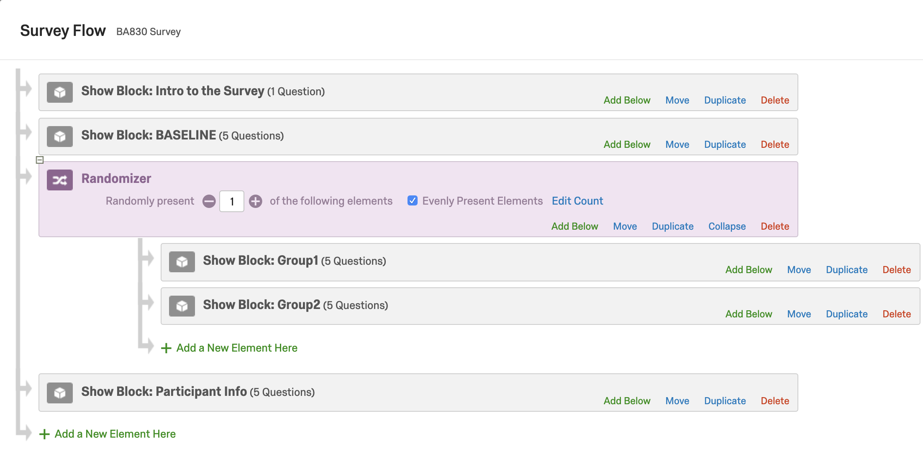
Experiment Design
Flow of the survey
Class, Personality, GPA
Excludability:
Question selection
Question order
Block order
Class, Personality, GPA
Class, Personality, GPA
Gender, Class, Personality, GPA
Notes:
Previous Q will not affect the next

Slide 6
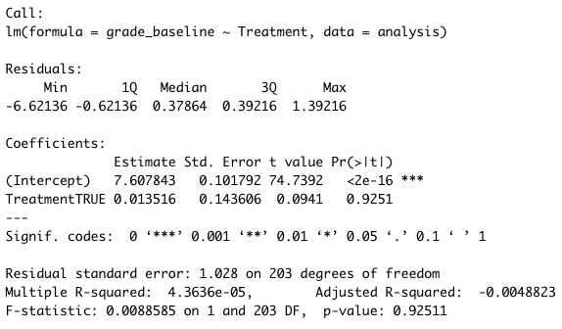
Balance Check
Fail to reject the null hypothesis -> Randomized assigned to treat/control
Treatment does not have an effect on baseline person grade
The validity of the research study's conclusion is high.

Slide 7
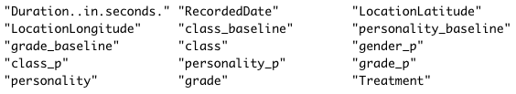
Statistics About the Data
205 observations and 15 variables
103 in Treatment Group
102 in Control Group
Baseline person: “_baseline”
Participants: “_p”
Testing person: no suffix

Slide 8
Statistics About the Data
Dummies:
Male(1) vs. Female(0)
Logical(1) vs. Emotional(0)
Grade: (1-9)
1-9 stand for Below C- to A
Class: (7)
Freshman, Sophomore, Junior, Senior, Master, PhD, Others

Slide 9
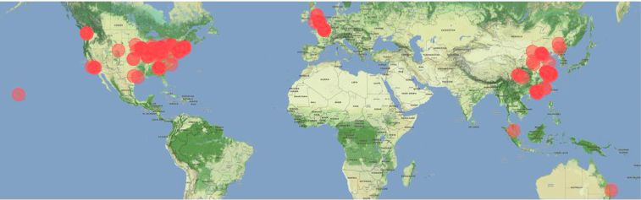
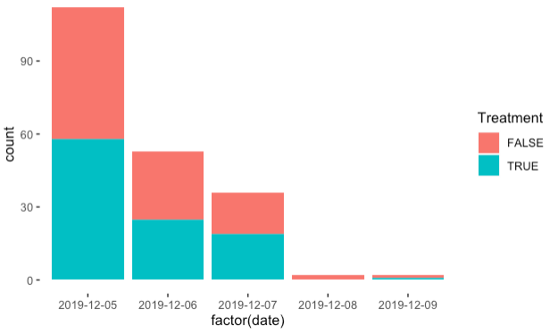
Participants Location Visualization (world map)
Took this survey at different times.
The probability of interference is low.

Slide 10
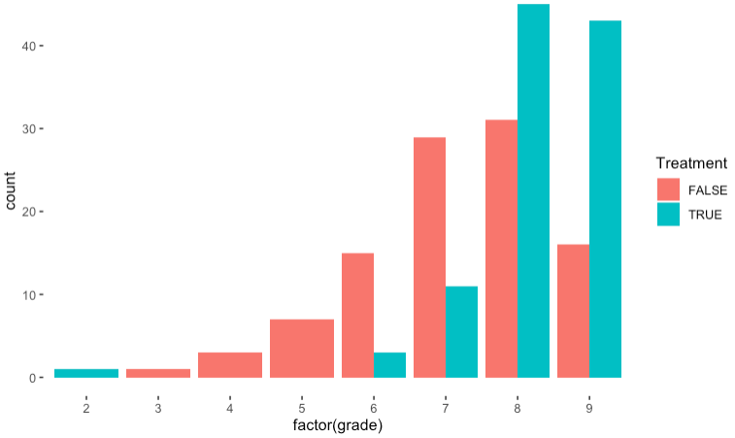
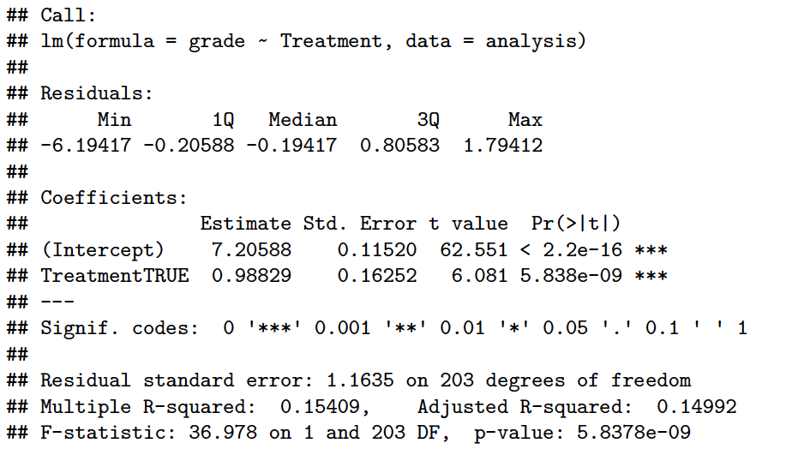
Experiment Data
Grade: Treatment Group > Control Group
ATE: 0.98829
P-value: <0.05
This causal effect is statistically significant.

Slide 11
Treatment Effect
Fixed Effect Check
Grade_Baseline P-value = 9.889e-08***
Personality_p P-value = 0.056235
Gender_p P-value = 0.030423**
Causal Effect Model with Fixed Effect
summary(felm(grade~Treatment,data=analysis))
p-value=5.838e-09 std.err=0.16252 Adjusted R-squared= 0.14992
summary(felm(grade~Treatment | grade_baseline + gender_p,data=analysis))
p-value=8.977e-12 std.err=0.13825 Adjusted R-squared= 0.30731 ATE: 01.00573

Slide 12
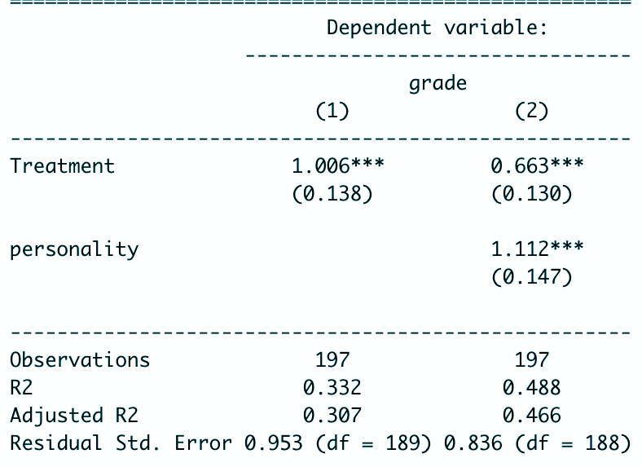
Limitations
01
02
03
04
05
Sample Selection Bias
Participants: friends instead of random participants
Interference
Unsure about user level interference
Questionnaire Design Limitation
Personalities question interfere judgment on GPA
Photo Representativeness Limitation
Selection of photos include only 1 race and 1 gender
Evaluation Scale Limitation
GPA Intelligence

Slide 13

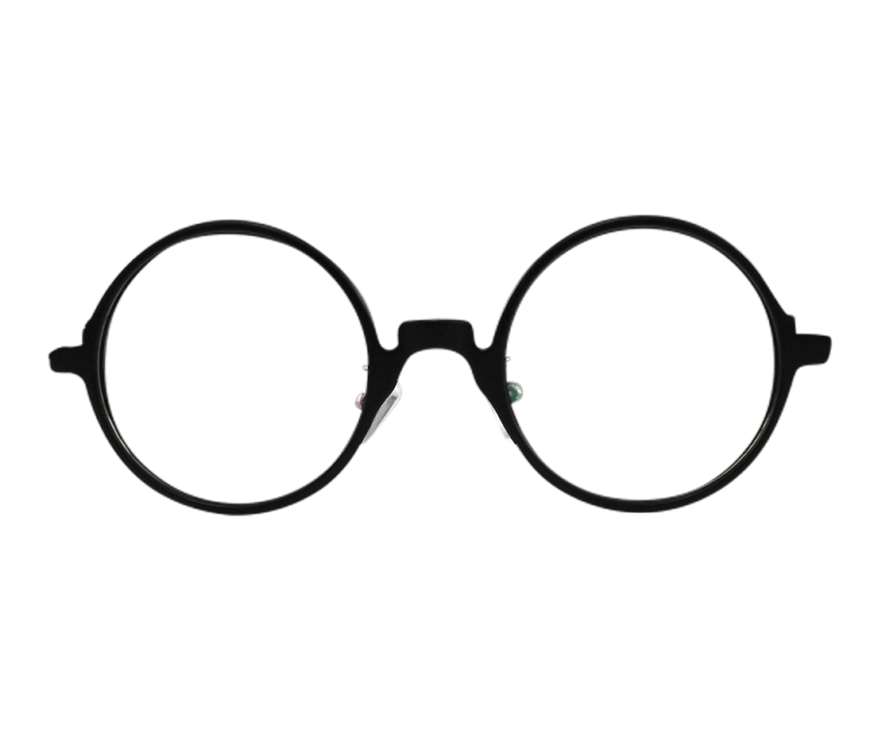

Conclusion
Look Smart

Slide 14

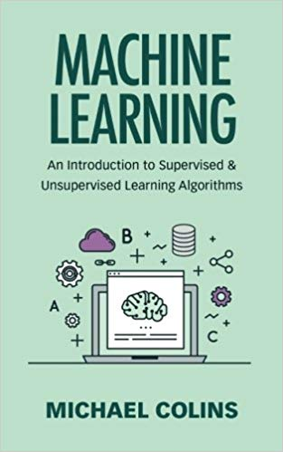
Thanks
Look Smart
Really Smart

